Slide 1
컴퓨터 네트워크 Computer Networks and Internets, 6e

Slide 2
Chapter 23 Support Protocols and Technologies

Slide 3
Assignment
2. An IP datagram has the following partial information.
45000054 00030000 2006…….
a) What is the size of the header and the data?
b) Is the packet fragmented?
c) What is the protocol number of the payload being carried by the packet?
d) How many more routers can the packet travel to?
2. An IP fragment has arrived with a fragment offset value of 100. How many bytes of data were originally sent by the source before the data in this fragment?
3. Capture packets using Wireshark, and explain fields in the IP header.
Send your solution to me by email. (Due date: Sat./ 24PM )
This assignment will be used to check your attendance.
© Pearson Education Inc., Upper Saddle River, NJ. All rights reserved.
3
Notes:
3

Slide 4
IP Datagram

Slide 5
23.1 Introduction
This chapter
continues the discussion of internetworking by introducing four key support technologies:
address binding
error reporting
bootstrapping
address translation
Each technology handles a small problem
When combined with other protocols
each makes a significant contribution to the overall functionality
Future chapters
extend the discussion of internetworking
by focusing on transport layer protocols and Internet routing protocols

Slide 6
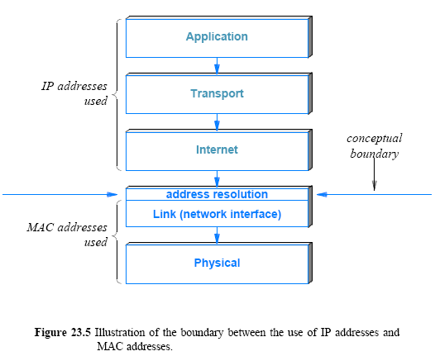
23.7 The Conceptual Address Boundary

Slide 7
Thought Problem
ARP is sometimes cited as a security weakness
If someone gains access to a given network, how can they exploit ARP to intercept packets?

Slide 8
23.8 Internet Control Message Protocol (ICMP)
IP defines a best-effort communication service
datagrams can be lost, duplicated, delayed, or delivered out of order
It seems best-effort service does not need error detection!
But IP attempts to avoid errors and to report problems when they occur
We have already seen one example of error detection in IP:
Header checksum is used to detect transmission errors
When a host creates an IP datagram
the host includes a checksum that covers the entire header
Whenever a datagram is received
the checksum is verified to ensure that the header arrived intact
The IP header contains a TIME TO LIVE field used to prevent a datagram from circulating forever
if the forwarding tables in routers incorrectly introduce a circular path

Slide 9
23.8 Internet Control Message Protocol (ICMP)
Response to a checksum error is following:
Datagram must be discarded immediately without more processing
IP’s TTL (hop limit) can detect a routing loop
A reassembly timer can detect lost fragments
Only some types of errors can be reported
IP includes a companion protocol, ICMP
It is used to report errors back to the original source
IP and ICMP are co-dependent
IP depends on ICMP to report errors
and ICMP uses IP to carry error messages
Many ICMP messages have been defined
Figure 23.6 lists key ICMP messages and their purpose

Slide 10
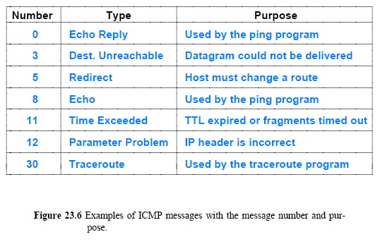
23.8 Internet Control Message Protocol (ICMP)
TYPE (8) CODE(8) Checksum(16)
DATA1 (32) : ID(16) SEQ. No.(16)
DATA2 (variable size)

Slide 11
23.8 Internet Control Message Protocol (ICMP)
As in Figure 23.6, ICMP contains two message types:
messages used to report errors
messages used to obtain information
For example
Time Exceeded and Destination Unreachable are for reporting errors
when a datagram cannot be delivered successfully
A destination is unreachable if no route exists to the address
A datagram times out if
either the TTL count in the header expires or
fragments of the datagram do not arrive before the timer expires
Echo Request and Echo Reply do not correspond to an error
Instead, they are used by the ping application to test connectivity
When a host receives an echo request message
ICMP software on a host or router sends an echo reply that carries the same data as the request

Slide 12
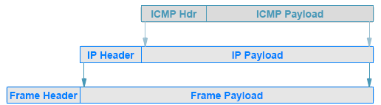
23.9 ICMP Message Format and Encapsulation
ICMP uses IP to transport each error message:
when a router has an ICMP message to send
it creates an IP datagram and encapsulates the ICMP message in it
the ICMP message is placed in the payload area of the IP datagram
the datagram is then forwarded as usual
with the complete datagram being encapsulated in a frame for transmission
Figure 23.7 (below) illustrates the two levels of encapsulation

Slide 13
ICMP Message

Slide 14
ICMP Message

Slide 15
ICMP Message

Slide 16
23.9 ICMP Message Format and Encapsulation
If an ICMP error message causes an error
no error message is sent
The reason should be clear:
the designers wanted to avoid the Internet becoming congested carrying error messages about error messages

Slide 17
23.9 ICMP Message Format and Encapsulation
If an ICMP error message causes an error
no error message is sent
The reason should be clear:
the designers wanted to avoid the Internet becoming congested carrying error messages about error messages

Slide 18
Protocol Configuration
Many items must be set before protocols can be used
– IP address of each network interface
Address mask for each network
Initial values in the forwarding table
Process is known as protocol configuration
Usually occurs when operating system boots
Two basic approaches
Manual (Used for IP routers or host that has a permanent IP address)
Automatic(Used primarily for hosts)
Automatic configuration requires a computer to be able to use a network before the computer’s protocol parameters have been configured.

Slide 19
Ways To Solve The Paradox
Use layer 2 protocols to obtain layer 3 parameters, then use layer 3 to obtain higher layers
Historic approach
– Relied on Ethernet broadcast
One computer on a network responded to requests
Use layer 3 to obtain all parameters
– Current approach
Relies on IP broadcast (IPv4) or multicast (IPv6)
Means routers can forward requests to a remote server

Slide 20
Dynamic Host Configuration Protocol (DHCP)
The standard protocol for automatic configuration
Popular in private enterprises as well as with service providers
Host broadcasts/multicasts a request and receives a reply
Single message exchange allows a host to obtain
An IP address and address mask to use
The IP address of a default router
The address of a DNS server
A DNS name
The location of an image to boot (optional)
An ISP using DHCP can choose which IP address to assign to a customer at a given time (Client-Server)

Slide 21
Dynamic Host Configuration Protocol (DHCP)
Significant features of the protocol (at application layer)
– Recovers from loss or duplication
– Host discovers DHCP server once and caches server
address for future interaction
Derived from BOOTstrap Protocol (BOOTP), but adds
dynamic address assignment

Slide 22
Dynamic Host Configuration Protocol (DHCP)
DHCP server
– Owns a set of IP addresses
– Chooses an address from the set when a request arrives
– Issues a lease for the address for specified time, T
Client
– Obtains an address and starts a timer for T time units
– Uses the address to communicate
– When the timer expires, requests the server renew the lease
– Either receives a renewal and restarts timer or stops
using the address

Slide 23
23.15 Network Address Translation (NAT)
The Internet has expanded and addresses became scarce
subnet and classless addressing (CIDR) were introduced to help conserve addresses
Another mechanism was invented that allows multiple computers at a site to share a single, globally valid IP address, known as Network Address Translation (NAT)
Most implementations embed NAT in another device
such as a Wi-Fi wireless access point or an Internet router
Service is transparent
No change in protocols on local hosts
No change in protocols on Internet servers
© Pearson Education Inc., Upper Saddle River, NJ. All rights reserved.
23
Notes:
23

Slide 24
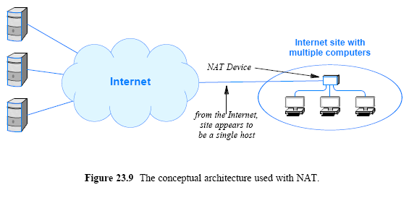
23.15 Network Address Translation (NAT)
Figure 23.9 (below) illustrates a typical arrangement of a site that uses NAT

Slide 25
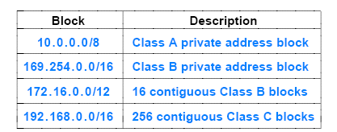
23.16 NAT Operation and Private Addresses
NAT solves the problem by using two (2) types of addresses
The NAT device itself is assigned a single globally-valid IP address
Each computer at the site is assigned IPv6 link-local or IPv4 private
NAT device runs a DHCP server to hand out IP addresses to computers at the site
© Pearson Education Inc., Upper Saddle River, NJ. All rights reserved.
25
Notes:
25

Slide 26
NAT Variants
Basic NAT
Only translates IP addresses
Seldom used in practice
NAPT
Translates IP address and transport-layer port numbers
Most widely-used type of NAT
© Pearson Education Inc., Upper Saddle River, NJ. All rights reserved.
26
Notes:
26

Slide 27
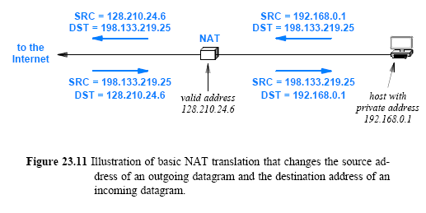
23.16 NAT Operation and Private Addresses
Figure 23.11 (below) illustrates the translations that occur in each direction
© Pearson Education Inc., Upper Saddle River, NJ. All rights reserved.
27
Notes:
27

Slide 28
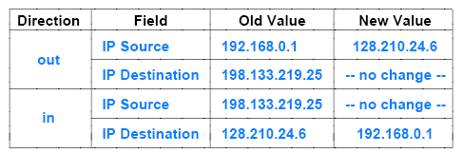
23.16 NAT Operation and Private Addresses
Most implementations of NAT use a translation table
to store the information needed to rewrite addresses
Figure 23.12 (below) shows a translation table that corresponds to the address mapping in Figure 23.11
© Pearson Education Inc., Upper Saddle River, NJ. All rights reserved.
28
Notes:
28

Slide 29
23.17 Transport-Layer NAT (NAPT)
Handles TCP, UDP, and ICMP
Translates TCP/ UDP protocol port numbers as well as IP addresses
Permits multiple computers at a site to contact the same Internet service simultaneously without interference
Examples:
Two computers at a site download songs from iTunes
Three computers at a site contact Google simultaneously

Slide 30
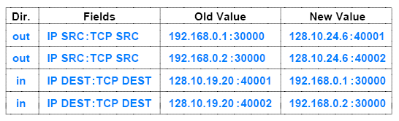
23.17 Transport-Layer NAT (NAPT)
Computers at site have private addresses assigned from private address block 192.168 / 16
Two computers at the site each contact TCP port 30000 on computer 128 210.19.20
NAPT chooses a new port number for each and translates
© Pearson Education Inc., Upper Saddle River, NJ. All rights reserved.
30
Notes:
30

Slide 31
23.18 NAT and Servers
NAT system builds a translation table automatically
by watching outgoing traffic and establishing a new mapping whenever an application at the site initiates communication
Automatic table construction does not work well for communication initiated from the Internet to the site
For example, if multiple computers at a site each run a web server
the NAT device cannot know which computer should receive an incoming web connection

Slide 32
23.19 NAT Software and Systems for Use at Home
A NAT software can make a PC act as a NAT device
Also, dedicated NAT hardware systems are available at low cost
Such systems are usually called wireless routers
The terminology is slightly misleading because such routers also provide wired connections for host computers

Slide 33
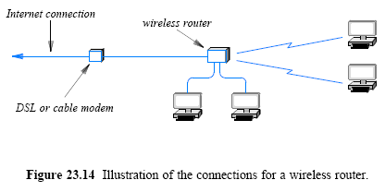
23.19 NAT Software and Systems for Use at Home

Slide 34
Chapter 24 The Future IP (IPv6)

Slide 35
24.1 Introduction
This chapter
concentrates on the future of the Internet Protocol
begins by assessing the strengths and limitations of the current version of IP
considers a new version of IP that the IETF has developed
explains features of the new version
shows how they overcome some of the limitations of the current version

Slide 36
24.2 The Success of IP
The current IP (IPv4) has been extremely successful
IP has made it possible for the Internet
to handle heterogeneous networks
The Hourglass Model (Appls – IP – Networks)
IP lies in the middle — changing it means changing all
hosts and routers in the Internet
To accommodate heterogeneous hardware, IP defines
a network-independent addressing scheme
datagram format
encapsulations
fragmentation strategy
The versatility and scalability of IP are evident
from the applications that use IP and from the size of the global Internet

Slide 37
24.3 The Motivation for Change
When IP was defined, the 32 bits IP address were selected
doing so allowed the Internet could include over a million networks
The global Internet is growing exponentially
Its size is doubling in less than a year
Motivation for defining a new version of IP?
the address space limitation
larger addresses are necessary to accommodate continued growth
special facilities are needed for some applications
Consequently, when IP is replaced
the new version should have more features
For example, is has been argued that a new version of IP should provide a mechanism for carrying real-time traffic to avoid route changes

Slide 38
24.3 The Motivation for Change
A new version of IP should accommodate more complex addressing and routing capabilities
In particular, it should be possible to configure IP addressing and routing to handle replicated services
For example, Google maintains many data centers
When a user enters google.com into a browser, it would be efficient if IP passed datagrams to the nearest Google data center
Many current applications allow a set of users to collaborate
To make collaboration efficient
Internet needs a mechanism that allows groups to be created or changed
It needs a way to send a copy of a packet to each participant in a given group
© Pearson Education Inc., Upper Saddle River, NJ. All rights reserved.
38
Notes:
38

Slide 39
24.5 A Name and a Version Number
Researchers selected IP The Next Generation
and early reports referred to the new protocol as IPng
many competing proposals were made for Ipng
New IP version number that was selected as a surprise
Because the current IP version number is 4 (IPv4)
the networking community expected the next official version to be 5
version 5 was assigned to an experimental protocol known as ST
The new version of IP received 6 as its official version number (IPv6)

Slide 40
24.6 IPv6 Features
IPv6 retains many of the successful features of IPv4 design, such as
Like IPv4, IPv6 is connectionless
Like IPv4, the header in a datagram contains a maximum number of hops the datagram can take before being discarded
Features of IPv6 can be grouped into a number of broad categories:
Address Size
Instead of 32 bits, each IPv6 address contains 128 bits.
The resulting address space is large enough to accommodate continued growth of the world-wide Internet for many decades
Suffix can be derived from MAC address
3 level address hierarchy(Global Prefix – Subnet – Interface(64))

Slide 41
24.6 IPv6 Features
Header Format
The header is completely different from the IPv4 header
Almost every field in the header has been changed (some were replaced)
Extension Headers
IPv6 encodes information into separate headers
A datagram consists of the base IPv6 header followed by zero or more extension headers, followed by data
Support for Real-Time Traffic
a mechanism exists that allows a sender and receiver to establish a high-quality path and to associate datagrams with that path
the mechanism is intended for use with audio and video applications
the mechanism can also be used to associate datagrams with low-cost paths
Extensible Protocol
IPv6 allows a sender to add additional information to a datagram
The extension scheme makes IPv6 more flexible than IPv4
and means that new features can be added to the design as needed
© Pearson Education Inc., Upper Saddle River, NJ. All rights reserved.
41
Notes:
41

Slide 42
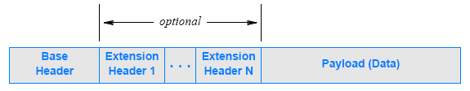
24.7 IPv6 Datagram Format
An IPv6 datagram contains a series of headers
As Figure 24.2 (below) illustrates
each datagram begins with a base header
followed by zero or more extension headers
followed by the payload
Fields are not drawn to scale
some extension headers are larger than the base header
In many datagrams, the size of the payload is much larger than the size of the header

Slide 43
Address Binding With IPv6
IPv6 does not use ARP
Instead, IPv6 defines a new address binding mechanism known as IPv6 Neighbor Discovery (IPv6-ND)
IPv6-ND
– Maintains a neighbor cache
– Keeps the cache up-to-date at all times
IPv6-ND operation
Sends a multicast request to find neighbors and populate the cache
Polls neighbors periodically, even if no datagrams are being sent to the neighbor

Slide 44
IPv6 Configuration
DHCPv6 has been defined, but...
IPv6 prefers a new procedure known as
IPv6 autoconfiguration
General idea: host can generate an address without using a
server
Motivation: allow two hosts to communicate without further
infrastructure
Obtain a network prefix
– Convention is to use a /64 prefix
– Globally-valid prefix can be obtained from a router
– Local-scope prefix created if no router available
Generate a unique suffix (…..start with MAC address)

Slide 45
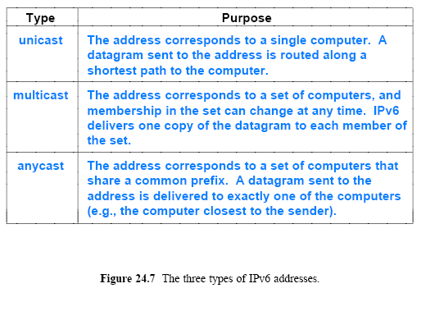
IPv6 Addressing

Slide 46
24.13 IPv6 Colon Hexadecimal Notation
IPv6 address occupies 128 bits
writing such numbers can be unwieldy
Consider a 128-bit number in the dotted decimal notation:
105.220.136.100.255.255.255.255.0.0.18.128.140.10.255.255
To reduce the number of characters used to write addresses
colon hexadecimal notation, usually abbreviated colon hex
69DC : 8864 : FFFF : FFFF : 0 : 1280 : 8C0A : FFFF
An additional optimization known as zero compression further reduces the size
FF0C:0:0:0:0:0:0:B1 → FF0C : : B1
Any IPv6 address that begins with 96-zero bits contains an IPv4 address in the low-order 32-bits

Slide 47
Assignment
1. Will an ICMP error message is generated if error is found in
a) a datagram having a multicast address ?
b) a datagram carrying an ICMP error message ?
c) a fragmented datagram that is not the first datagram ?
2. Compare NAT and DHCP. Both can solve the problem of a shortage of addresses in an organization, but by using different strategies.
3. Run wireshark and execute ping command.
Capture various packets using Wireshark, and explain fields in ICMP header.
Send your solution to me by email. (Due date: Sat. /24PM)
This assignment will be used to check your attendance.
© Pearson Education Inc., Upper Saddle River, NJ. All rights reserved.
47
Notes:
47

